Slide 1
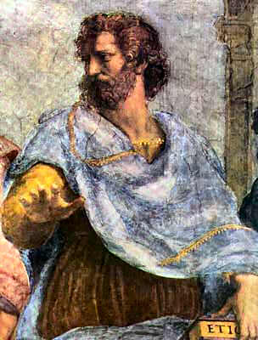
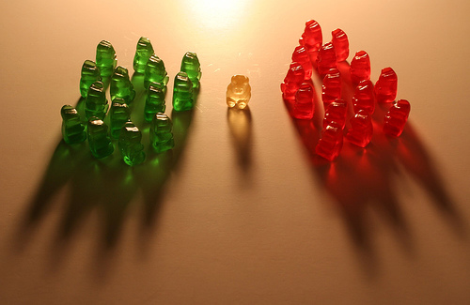
VIRTUE ETHICS
ETHICS BOWL

Slide 2
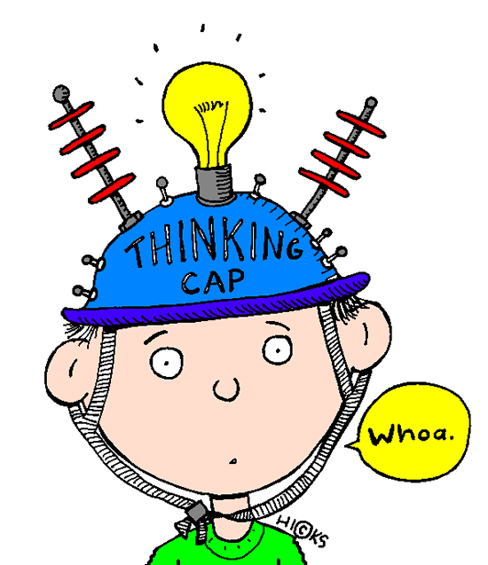
STARTER QUESTION
Think of someone who you think of as a good person.
It could be a family member, friend, someone famous – anyone!
Q: What makes this person good?
List the qualities or character traits they have that make them good.

Slide 3
“We are what we repeatedly do. Excellence, then, is not an act but a habit.”
Aristotle

Slide 4
“Happiness depends upon ourselves.”
Aristotle

Slide 5
What is virtue ethics?
Most ethical theories suggest a set of principles or rules than all human beings are bound by.
Consequentialism – the Greatest Good for the Greatest Number
Kantianism – the Universal Law
Virtue ethics is different:
It concentrates on the idea of the human character and asks how you can be a better person.

Slide 6
Three approaches to ethics
PERSON
ACTION
END
VIRTUE ETHICS
IT IS THE STATE A PERSON IS IN WHEN PERFORMING AN ACTION THAT MATTERS
CONSEQUENTIALISM
THE END RESULT DETERMINES THE RIGHTNESS OR WRONGNESS
KANTIAN ETHICS
SOME ACTS ARE RIGHT OR WRONG IN THEMSELVES (DUTY)

Slide 7
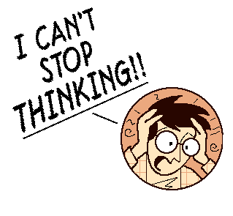
What is virtue ethics?
Utilitarians and Kantians think that “what is it right to do?” is the most important question in ethics. They concentrate simply on moral decision-making.
Virtue theory puts this the other way round – right character comes BEFORE right behaviour.
“How should we be?” is the most important question, because it is only by becoming better people that we will do the right thing.
YOU HAVE TO HAVE THE RIGHT CHARACTER IN ORDER TO BE ABLE TO CHOOSE THE RIGHT ACTIONS.
Virtue theory is concerned with the process of how to become a moral person. Once you have become a moral person – you will do the right thing.

Slide 8
The beginnings
Virtue ethics actually came before Consequentialism and Kantian ethics – it was invented in Ancient Greece by a philosopher named ARISTOTLE.
Aristotle’s basic idea was that we can decide what it is for something to be in a good state by looking at its PURPOSE.
e.g. a good knife is one that cuts well.
The purpose of human life, said Aristotle, is to attain HAPPINESS.
This is what all of us aim at in our actions.

Slide 9
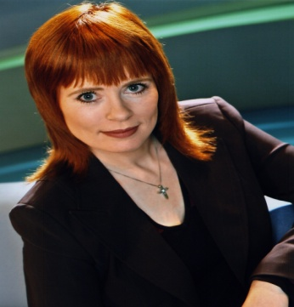
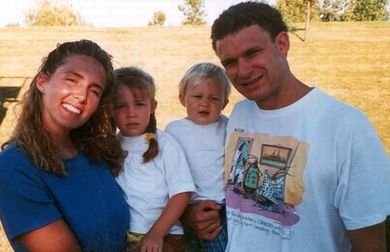
Actions And aims
Aristotle believed that every human action is directed towards an aim.
I get up in the morning because I want to go to work.
I go to work because I want to earn a living and have a career.
I want earnings and career so that I can have a good life.

Slide 10
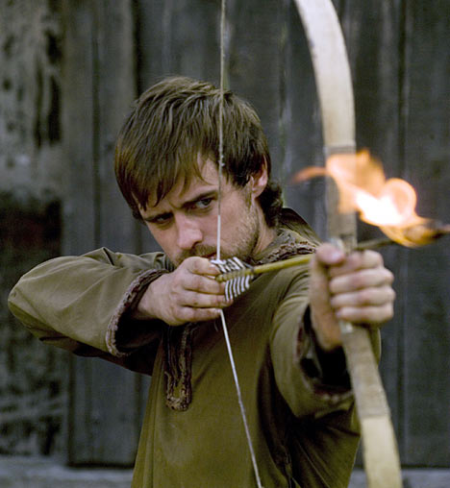
The goal of humanity
Aristotle thought that to be truly happy, you must become a virtuous person. This is the most fulfilling position to be in.
The virtuous person will act morally because they want to, since they know it makes them happy.
Virtue is not an easy state to achieve, and it takes hard work and practice, as well as the right upbringing.
Virtue ethics is a life study: the virtuous life is an ongoing project that you must work on at all times.
We are like Archers aiming at a target of goodness.

Slide 11
ActivitY
Think of a moral dilemma in terms of the character and virtues of the moral agent.
How does this differ from thinking about the moral situations in terms of consequences?
How does it differ from thinking about the moral situations in terms of right or wrong acts?

Slide 12
What is a virtue?
A Virtue is a character trait or quality that is good and contributes to happiness.
The opposite of virtue is vice.
Vices are personality traits that undermine your or others’ happiness. These are negative and should be avoided.
Virtues require different actions in different situations, so there are no absolutely good or bad actions.

Slide 13
How do you work out what a virtue is?
Virtue ethics can be seen as the “ethics of the average”.
It decides which is the correct moral virtue by working out the middle point between two extremes, each of which are vices.
One is a deficiency (not enough), the other an excess (too much) of the virtuous quality.
Aristotle thought there were 12 moral virtues that are each mid-points between extremes. This is called the “Doctrine of the Mean”. (mean = average)

Slide 14
The virtues
VICE OF DEFICIENCY | VIRTUOUS MEAN | VICE OF EXCESS
COWARDICE | COURAGE | RASHNESS
INSENSIBILITY | TEMPERANCE | SELF-INDULGENCE
MEANNESS | LIBERALITY | PRODIGALITY
STINGINESS | “MAGNIFICENCE” (GIVING) | TASTELESSNESS
HUMBLE-MINDEDNESS | MAGNANIMITY | VANITY
UNAMBITIOUSNESS | RIGHT AMBITION | OVER-AMBITION
SPIRITLESSNESS | GOOD TEMPER | IRASCIBILITY
SURLINESS | FRIENDLINESS | OBSEQUIOUSNESS
FALSE MODESTY | SINCERITY | BOASTFULNESS
CANTANKEROUSNESS | WITTINESS | BUFFOONERY
SHYNESS | MODESTY | SHAMELESSNESS
CALLOUSNESS | RIGHTEOUS INDIGNATION | ENVY

Slide 15
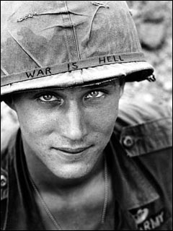
EXAMPLE: Courage
A soldier in Iraq sees his mate fall in battle. He could:
ACTION
EXCESS/DEFICIENCY
VICE/VIRTUE
Leave him and run away.
Go chasing after him without any regard for his own safety.
Organise a plan using other members of his team to rescue the fallen soldier.
Which act rests on which end of the scale?
Can you come up with another example? Another virtue?

Slide 16
ActivitY
Compile a list of virtues suitable for the 21st century.
Decide on the ‘vice of deficiency’ and ‘vice of excess’ for each of your virtues.
Describe what you think a completely virtuous life and a completely virtuous society would look like.

Slide 17
Strengths and weaknesses: relativity
Aristotle understood virtues relatively.
He claimed there is no sense of absolute good or evil beyond our world.
The virtues of one society may differ from another depending on the needs of that society; e.g. in a society at war, courage and bravery would be highly prized.
Any society in the world can follow virtue ethics. They just need to work out what is important to them and what virtues they value.

Slide 18
Strengths and weaknesses: humanistic
Virtue ethics does not need a God to justify why we should be moral.
It gets its backing from human nature.
This means that it has a lot of attraction for non-religious people.
It is also compatible with a religious point of view; many religions point to examples of virtuous people to teach us how to behave (What Would Jesus Do?).

Slide 19
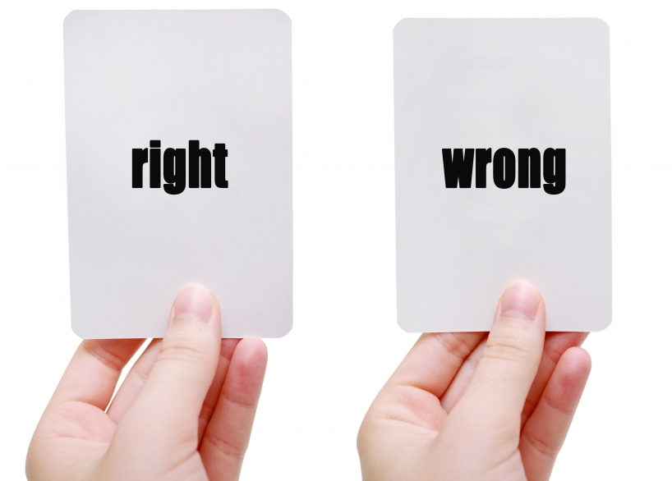
Strengths and weaknesses: individual freedom
Virtue ethics does not give prescriptive rules or laws that you should follow.
Rather than looking for rules it looks at what it is to be human.
This gives more freedom to the individual to choose how to act; the agent is in complete control of their own morality.
It is up to us to become the kind of people we want to be.

Slide 20
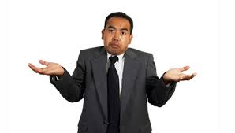
Strengths and weaknesses: accepts mistakes
Virtue ethics evaluates the whole person.
We are not judged simply on one mistake; rather, our whole lives are taken into consideration.
People can change. We can and should work to slowly become more virtuous.
As long as you are making an effort to change your personality and are attempting to practise the virtues then you are doing the right thing.

Slide 21
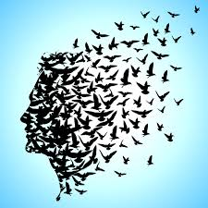
Strengths and weaknesses: individual freedom
One of the theory’s strengths is its weakness. Virtue theory does not give you a list of right and wrong acts, nor does it give you a method to work out what would go on this list.
Virtue ethics claims to be interested in making society better, but how can a society develop when there are no rules?
How do we punish people who act immorally?
Those people that are lost will remain lost if there is nothing for them to follow. Will they ever be happy?

Slide 22
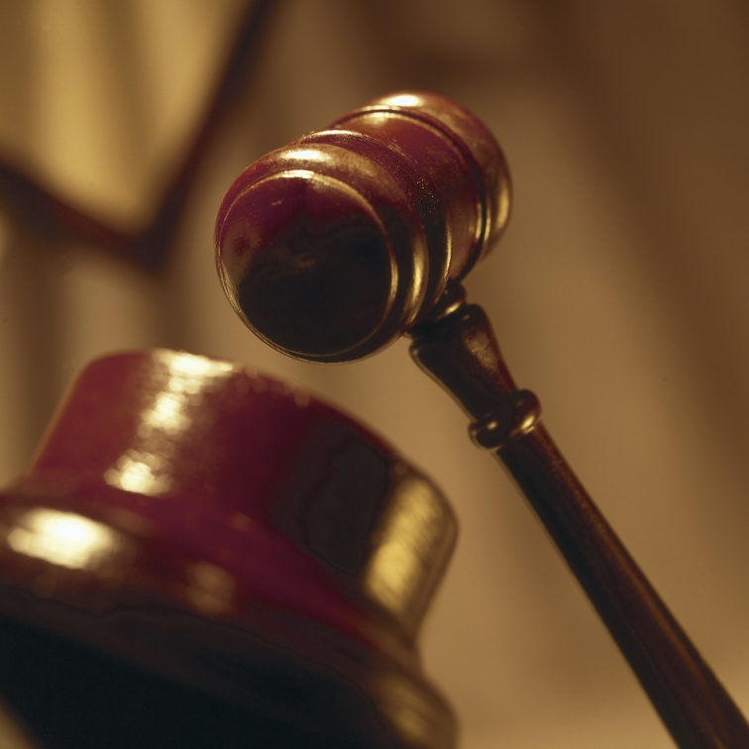
Strengths and weaknesses: HOW DO WE JUDGE PEOPLE?
The person who acts badly by accident whilst trying to be virtuous is better than the person who is not trying at all.
But how do we know they are trying to act virtuously??
It is difficult to decide who is virtuous, as external acts that appear virtuous on the outside may have doubtful inner motives which we cannot see, and vice-versa.

Slide 23
Strengths and weaknesses: virtue ≠ happiness
Using virtue ethics you are supposed to aim your life towards happiness.
But sometimes the right thing for me to do is not good for me.
In cases of charity and justice, sometimes I should sacrifice my own interests for those of others.
I may have to give up luxuries so that the basic needs of others can be met.

Slide 24
Strengths and weaknesses: ELITIST
Aristotle claims that a person who does not have a formal education can never reach true morality, because they have not been educated in the virtues.
It seems wrong to say that just because someone is uneducated and poor, they cannot be moral.
If they have to overcome greater struggle with vice, this might be better than always being motivated to do the right thing.

Slide 25
Applying virtue theory
The difficulty is that the theory is concerned with more than actions. It is concerned with the character of the individual.
We must look at the upbringing, education and behaviour of people on a day-to-day basis.
Virtue ethics is relativistic, so we should consider each scenario differently.
We need to apply virtue ethics to a scenario by considering its wider context.

Slide 26
Applying virtue theory
What we have to consider for each scenario
Who are the moral agents?
What sort of characteristics should they be demonstrating?
Is the act good for them and/or for society?
Would certain options encourage bad or good habits if chosen?
What would be the most virtuous thing to do – considering a number of virtues?
Are there conflicting virtues – does one option reflect one virtue and another a different virtue?
To what extent do your conclusions depend on agreement about what virtues there are?
Do these conclusions seem unreasonable / reasonable?

Slide 27
What is the scenario?
1

Slide 28
Who are the moral agents?
2

Slide 29
Is the act good for them or good for society?
3

Slide 30
Would certain actions encourage good or bad habits?
4

Slide 31
What would be the most virtuous thing to do – considering a number of virtues?
5

Slide 32
Are there conflicting virtues – does one act reflect one virtue and another, another?
6

Slide 33
To what extent are your conclusions dependent on agreement about what virtues should be?
7

Slide 34
Are these conclusions reasonable?
8

