Slide 1
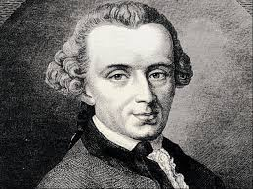
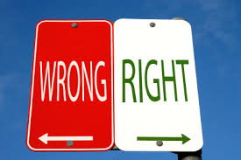
kantian ETHICS
ETHICS BOWL

Slide 2
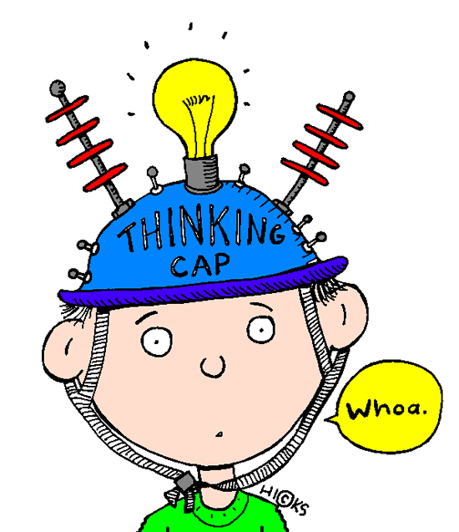
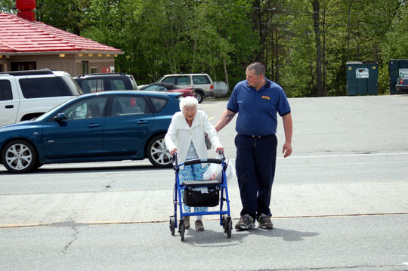
STARTER QUESTION
Think of as many different motivations as you can for why this person might be helping someone:
Do some of the motivations make the act better than others?

Slide 3
“Do your duty though the heavens fall.”
Immanuel Kant

Slide 4
“Good will, like a jewel, shines forth as something that contains its whole value within itself.”
Immanuel Kant

Slide 5
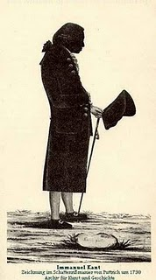
Who was kant?
Kant was basically a really weird guy.
He was born in a tiny village in Germany called Königsberg, and never travelled more than 10 miles outside of it during his entire life.
He had a very strict routine – the story goes that local people in Königsberg used to set their watches by the time Kant went by on this daily walk!
BUT he is perhaps the most influential philosopher of the past 300 years.

Slide 6
What is Kantian ethics?
Kant argued that most things we think of as good are not always good. Intelligence, wealth etc. could always be used for evil.
For Kant, the only thing that is always good in itself is a good will. (This is a kind of drive to do the right thing, whatever it is.)
We should want to act in a certain way because it is right, not because of the consequences.
Our job as moral agents is to work out what our duties are, and then to follow them.

Slide 7
Three approaches to ethics
PERSON
ACTION
END
VIRTUE ETHICS
IT IS THE STATE A PERSON IS IN WHEN PERFORMING AN ACTION THAT MATTERS
CONSEQUENTIALISM
THE END RESULT DETERMINES THE RIGHTNESS OR WRONGNESS
KANTIAN ETHICS
SOME ACTS ARE RIGHT OR WRONG IN THEMSELVES (DUTY)

Slide 8
ActivitY
Kant thought that only good will is good in itself, whilst Bentham thought that only pleasure is good in itself. Which of these views do you find more plausible?
How many other things can you convincingly argue are good in themselves?
How do we test for whether or not something is good in itself?

Slide 9
The importance of universalizability
Kant believed in an objective moral law, which we can work out using reason (our capacity for thinking).
All humans have the ability to reason, so we should all be able to work out the moral law.
This means that, for Kant, moral laws must be universal – they must be the kind of laws that everyone could discover and follow.

Slide 10
THE PRINCIPLE OF UNIVERSALIZABILITY
Kant thought that we can tell what our duties are by seeing whether our action can be universalized.
We have to ask ourselves, “What if everybody did that?”
E.g. murder cannot be universalized – if everybody murdered people who they did not like then there would be no people left!
Lying cannot be universalized – if everybody lied then nobody would believe what anybody says, and lying would be pointless!

Slide 11
The “categorical imperative”
Since moral laws must be universal, they cannot depend on a particular person’s circumstances or their desires.
Kant called these laws “categorical imperatives” – they identify principles that we should all always follow.
This is in contrast with “hypothetical imperatives” – principles that we should follow only if we have certain desires.

Slide 12
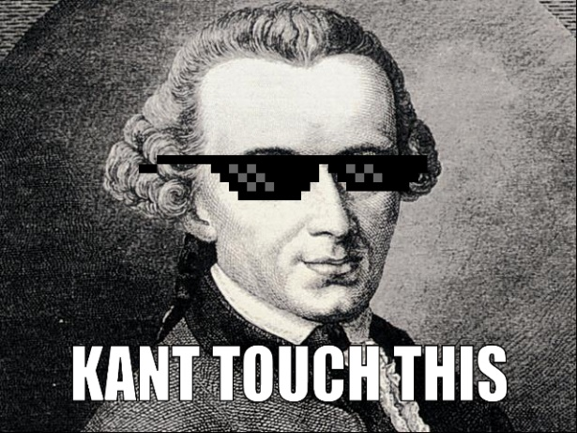
Treating people as “ends in themselves”
Kant thought that human reason was extremely valuable.
To respect other people’s reason, and their ability to discover and follow the moral law, we must never use them for our own purposes.
Kant expressed this by saying that we should never treat humanity “merely as a means” (to getting what we want), but “always as an end in itself”.

Slide 13
ActivitY
What are our duties?
Which of these acts follow principles that could be universalized, and which depend on people’s desire for certain consequences?
A shopkeeper gives a customer the right change because he likes the customer.
A shopkeeper gives a customer the right change because he thinks this is part of what all shopkeepers ought to do.
A shopkeeper gives a customer the right change because he wants to maintain a good reputation.

Slide 14
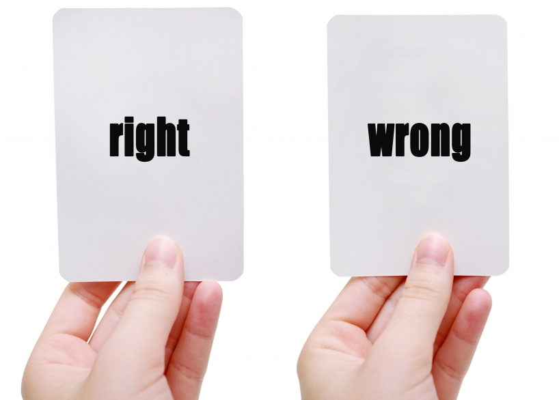
Strengths and weaknesses: easier to apply
Kantian ethics is often easier to apply to particular cases then consequentialism.
We do not have to know all of the consequences of an action to know whether it is wrong.
We just have to know what kind of action it is. Presumably we do know that, as we are thinking about doing it!
This is much easier to think about when we are trying to work out what to do.

Slide 15
Strengths and weaknesses: encourages autonomy
Kant thought it was important for people to work out for themselves what is right and wrong, using their reason.
This is better than blind reliance on authority – law, parents, sacred texts etc.
Kant said that we are only truly free when we choose our principles of action for ourselves.
He really wants us to think about it!!

Slide 16
Strengths and weaknesses: encourages respect
Kant’s principle of treating everyone as an end in themselves encourages respect for all persons.
Kant would not allow biases or prejudice to affect our moral thinking.
Since we have to do our duty out of good will alone for our action to be good, we cannot allow our feelings toward people to affect our moral thinking.

Slide 17
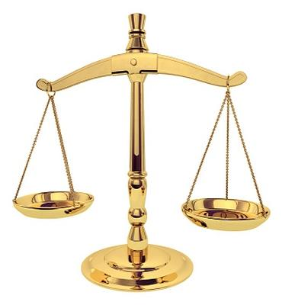
Strengths and weaknesses: promotes equality
The test of universalizability ensures that we cannot treat people unfairly in our moral principles.
A principle like “all men can vote but women cannot” would not be accepted by half of the moral agents in the world!!
For Kant, the human is the focal point of morality. It is our common humanity that makes us moral agents & makes us valuable.

Slide 18
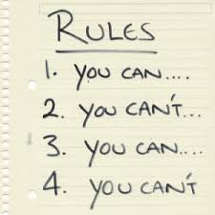
Strengths and weaknesses: are any acts really always wrong?
Kant claims that the moral laws identify actions that are always wrong, no matter what the circumstances.
This is very implausible.
Even his most famous examples are not very convincing: in some circumstances, breaking a promise might save hundreds of lives!
Even killing someone might save more lives!
It looks like consequences do matter.

Slide 19
Strengths and weaknesses: too general & vague
Kantian ethics can be difficult to apply to particular cases because it is not clear which “principle” lies behind each particular action.
E.g., is my action lying?
Is it lying to make someone feel better?
Is it lying to make someone feel better because I need them to do something for me?
If we describe the action specifically enough, then we could “universalize” pretty much anything.

Slide 20
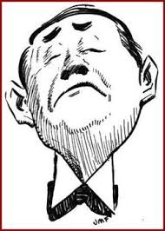
Strengths and weaknesses: cold and impersonal
When we are actually making moral decisions, love and compassion matter.
The requirement to be motivated only by a sense of duty makes morality too cold and impersonal.
If my child is drowning and I save her because I love her, how can my action be morally wrong?
We should help people because we care about them, not because of a sense of duty!!

Slide 21
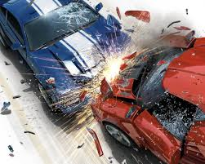
Strengths and weaknesses: what if duties conflict?
Kantian ethics gives us no guidance as to what to do when duties conflict – this seems not to have occurred to him!
E.g. Promise-keeping is a duty, but what if I have promised to two different people to be in two places at the same time?
What if I have promised to lie to someone?
What if I three people are drowning and I only have time to save one of them?
Moral dilemmas are real – there are times when we violate a duty no matter what we do.

Slide 22
ActivitY – DEBATE!!
“Kantian ethics is a better ethical theory than consequentialism”.
Do you agree?
Half the group are going to argue for Kantian ethics, whilst the other half argue for consequentialism.
You must take notes as the other team is arguing as you will have the chance to respond afterwards!
You have 5 MINUTES TO PREPARE…

